Slide 1

Python Fundamentals
Course Introduction
SoftUni Team
Technical Trainers
Software University
http://softuni.bg

Slide 2


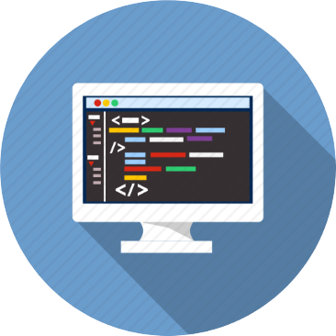
Table of Contents
Course Objectives
Course Program
Trainers Team
Course Schedule
Exams and Evaluation
Learning Resources

Slide 3
Questions
sli.do #python-fund

Slide 4
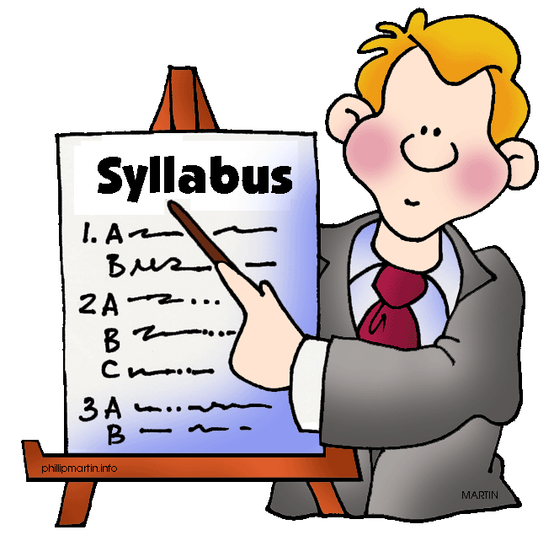
Python Fundamentals
Course Objectives & Program

Slide 5


Python Fundamentals – Course Program
Course Introduction – Course Program, Trainers, Exams, Resources
Python Intro – IDE Installation, Data Types & Variables
Functions and Debugging – Defining Functions, Debugging Code
Lists and Dictionaries – Definition, Usage, List Slicing, List Comprehension
Functional Programming – Lambda functions
Objects and Classes – Defining Classes, Instantiating Objects, Constructors

Slide 6
Python Fundamentals – Course Program (2)
Files and Error Handling, Regex – File I/O, Python Errors, Using re Class
Strings and Text Processing – String Functions (find, startswith, etc.)
Inheritance – Python Inheritance mechanism
Exam Preparation – Practical Exam Problems
Practical Exam – 4 Problems for 6 Hours

Slide 7

The Trainers Team

Slide 8

The Trainers Team
Ines Ivanova
Top student @ SoftUni
Front-end developer
Works at a startup in the area of data science
Python, C#, Angular 5, HTML, CSS, jQuery
In the free time enjoys learning C++

Slide 9

Python Fundamentals: More Details
Duration, Languages, Technologies

Slide 10


Training Duration – Python Fundamentals
Lessons: ~25 hours (onsite + videos)
Practical exercises (in class): ~30 hours
Exam preparation: 3 hours
Exam: 6 hours
Schedule: June – August 2018
Exam date: 12 August 2018
Retake Exam: 26 August 2018

Slide 11



Why English?
Why the slides are in English?
English is the native language of the software engineers
Specific terminology should be in English
Translations are inaccurate and funny
Just learn English!
No excuses

Slide 12
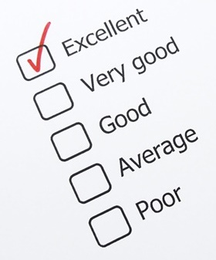
Python Fundamentals
Evaluation Criteria

Slide 13



Scoring System for “Python Fundamentals”
Exam – 90%
Homework (exercises) – 10%

Slide 14


Python Fundamentals Exam
Practical programming exam
4 practical problems for 6 hours
Lists, dictionaries, strings
Code in Python
Automated judge system
http://judge.softuni.bg
Solutions are evaluated for correctness only
Code quality is still not measured

Slide 15

Homework Assignments
Doing your homework is very important!
Programming can only be learned through a lot of practice!
You should write code every day!
Each lesson is followed by many exercises
Try to solve them in class
The rest are your homework
Homework assignments are due in 6 days after each lecture
Submission through our online judge system: judge.softuni.bg

Slide 16

Resources
What We Need Additionally?

Slide 17



PF Course Web Site, Forum and FB Group
Official web site:
Official discussion forum:
Official Facebook groups:
softuni.bg/opencourses/python-fundamentals-course
softuni.bg/forum/categories/39/python
facebook.com/groups/PythonFundamentalsJune2018/

Slide 18



The Python Fundamentals Slides and Videos
All lecture slides, videos, homework assignments, projects and other resources are open content, available for free
Visit the course web site to access the course resources

Slide 19

Software University Learning System (SULS)
Software University Learning System (SULS)
www.softuni.bg
Important resource for students
Homework submissions
Homework check-up
Exams and results
Reports about your progress
…

Slide 20


Required Software
Software needed for this course:
Microsoft Windows (Win 10 / 8.1 / Win8 / Win7) or Mac or Linux
Python 3.6.4 (Python 2 will NOT be used in this course)
JetBrains PyCharm Community 2017.3.2

Slide 21



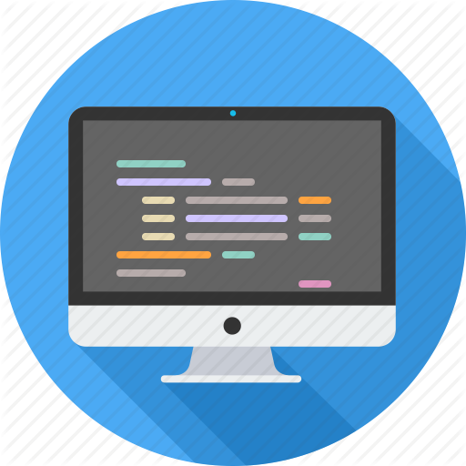

Summary
Training program
Data types, methods, debugging, arrays and lists, dictionaries, objects, strings and much more
Practical exam
4 problems for 6 hours
Learning resources
Slides, videos, software, books, forum

Slide 23













SoftUni Diamond Partners

Slide 24





SoftUni Organizational Partners

Slide 25

License
This course (slides, examples, demos, videos, homework, etc.) is licensed under the "Creative Commons Attribution-NonCommercial-ShareAlike 4.0 International" license

Slide 26
Trainings @ Software University (SoftUni)
Software University – High-Quality Education, Profession and Job for Software Developers
softuni.bg
Software University Foundation
http://softuni.foundation/
Software University @ Facebook
facebook.com/SoftwareUniversity
Software University Forums
forum.softuni.bg

